Slide 1
Alfalfa House FY20 Key Highlights

Slide 2
A BIG THANK YOU TO:
Allie (as Manager)
All the Shop Staff who are or have worked with us through this year:
Ran, Yue, Tallulah, Paulo, Marnie, Mariko, Georgie, Anna, Carina, Tayla, Roisin, Freya & Janet
The MC Board Bruce, Uppma, Lauren, Vicki, Ashton, Karl
The Vollies
The Members!

Slide 3
FY20 Results
Item | Year Ended 30 June 20 (FY20) | Year Ended 30 June 19 (FY20) | Movement ($) | Movement (%)
Net profit/(loss) before YE Adjustments | $17,382 | ($48,651) | +$66,033 | +136%
Post Year-end adjustment* | ($20,000) | - | ($20,000) | -100%
Adjusted Net (Loss) | ($2,618) | ($48,651) | +$46,033 | +95%

Slide 4
FY20 Sales & Gross Margin
Item | Year Ended 30 June 20 (FY20) | Year Ended 30 June 19 (FY20) | Movement ($) | Movement (%)
Sales | $1,106,732 | $1,065,732 | +$41,000 | +4%
Cost of Sales (COS) | ($729,370) | ($676,855) | ($52,515) | -8%
Gross Profit (Sales less COS) | $377,362 | $388,877 | ($11,515) | -3%
Gross Profit Margin | 34.10% | 36.49% | -2.39% | -2.39%

Slide 5
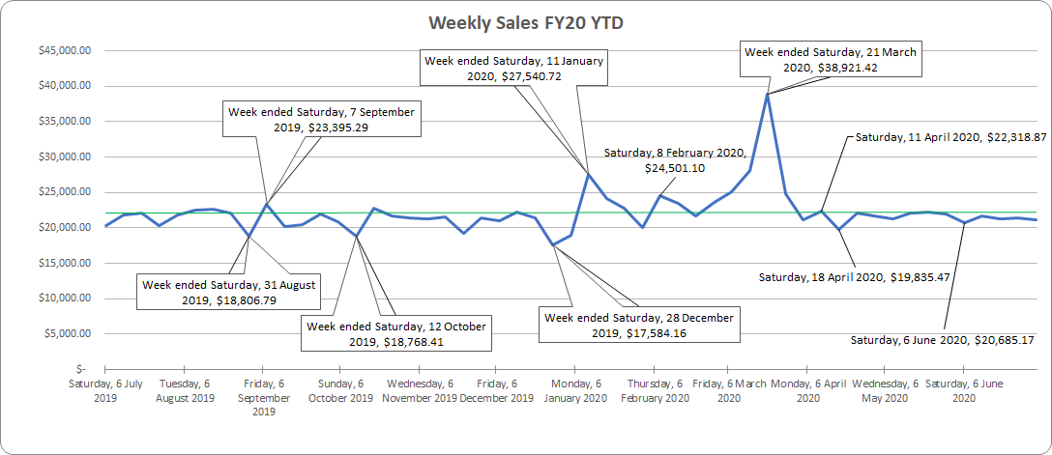
Weekly Sales FY20

Slide 6
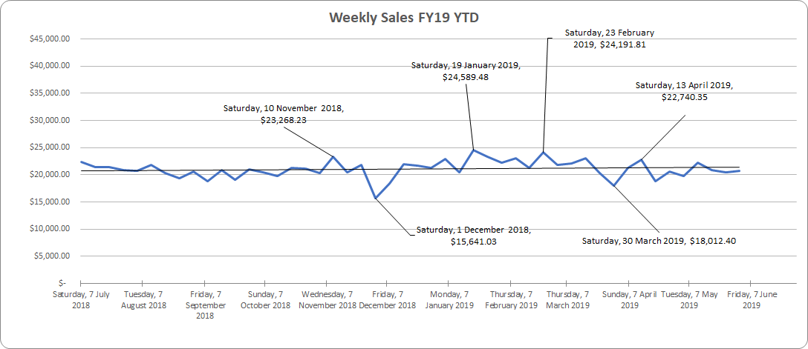
Weekly Sales FY19

Slide 7
FY20 Subscription Fees & ATO Cash Flow Boost
Item | Year Ended 30 June 20 (FY20) | Year Ended 30 June 19 (FY20) | Movement ($) | Movement (%)
Annual Subs Fee Revenue (Member Fees) | $33,592 | $17,002 | +$16,590 | +98%
ATO Cash Flow Boost (Gov’t stimulus) | $14,350 | - | +$14,350 | +100%

Slide 8
FY20 Key Cost Savings-Employee Benefits
Item | Year Ended 30 June 20 (FY20) | Year Ended 30 June 19 (FY20) | Movement ($) | Movement (%)
Salaries & Wages | $269,804 | $332,807 | +$63,003 | +19%
Super (+9.5% on Salaries) | $24,926 | $30,902 | +$5,976 | +19%
Accrual & Other Adjustments | $2,407 | ($9,568) | ($11,975) | -125%
Net Employee Benefits | $297,137 | $354,140 | +$57,003 | +19%

Slide 9
FY20 Key Cost Savings-Admin & Operating Costs
Item | Year Ended 30 June 20 (FY20) | Year Ended 30 June 19 (FY20) | Movement ($) | Movement (%)
Accounting & Bookkeeping | $13,232 | $19,895 | +$6,663 | +33%
Insurance | $17,091 | $21,188 | +$4,097 | +19%
Electricity | $7,316 | $8,333 | +$1,017 | +12%
R&M (Incl. Computer repairs) | $8,933 | $2,435 | ($6,498) | -267%
Other costs | $12,513 | $25,387 | +$12,874 | +51%
Total Costs | $59,085 | $77,238 | +$18,153 | +24%

Slide 10
FY20 Key Balance Sheet Items
Item | Year Ended 30 June 20 (FY20) | Year Ended 30 June 19 (FY20) | Movement ($) | Movement (%)
Cash | $62,925 | $23,486 | +$39,439 | +168%
Inventory/Stock | $38,890 | $34,401 | +$4,097 | +19%
Trade & Other Payables | ($49,522) | ($64,336) | +$14,814 | +23%
AL Loading Provision | ($20,000) | - | ($20,000) | -100%
Net Current Assets | $18,099 | ($18,878) | +$36,977 | +196%
Director Loans (Non-Current) | ($25,000) | - | ($25,000) | -100%
Net Total Assets | $48,840 | $51,458 | -$2,618 | -5%

Slide 11
Annual Leave Loading (& Associated Super)-Note 9
MC Board have contacted FWO (Fair Work Ombudsman) re Annual Leave Loading amounts owed & associated Super
The MC Have advised all affected employees
Process complex and extensive.
Calculations of amounts owed currently in review by MC & other independent Legal & Accounting professionals
Reviewed calculations to be provided to FWO to evaluate. We will abide by their decisions
Payment to affected employees will follow with further comms, once we have reached agreement with FWO

Slide 12
FY21 & Beyond
Sales down in 1st 4 months of FY21 (1 July 2020 onwards)
Opportunities now COVID restrictions loosening:
→ Events (e.g. tastings, workshops etc)
→ Opening Enmore Rd Entry to shop
Renewed Staff/MC Board focus on:
→Product Review
→Marketing/Social Media/Promotions
Volunteer Opportunities: →In shop
→Lease renewal re-negotiations
→Community/Member/Vollie Engagement (Events + broadening Alfalfa House’s Newtown prescence)
→Grants
→Spruiking Alfalfa House’s Sustainability cred
→Co-op of Co-ops

