Slide 1
Alfalfa House
Sales review
Jul 2020 – Sept 2021

Slide 2
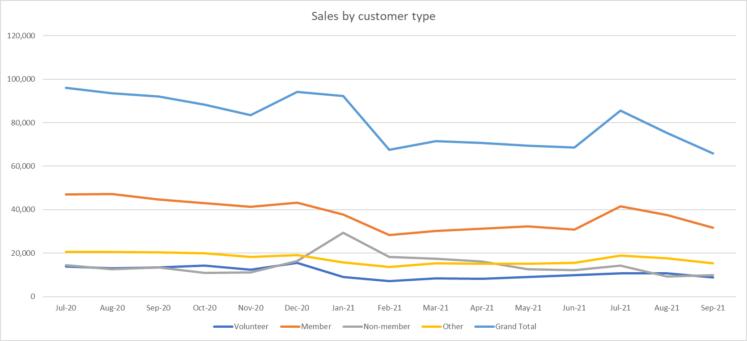
Total sales have declined by nearly 20% from Jul-Sept 2020 to Jul-Sept 2021

Slide 3
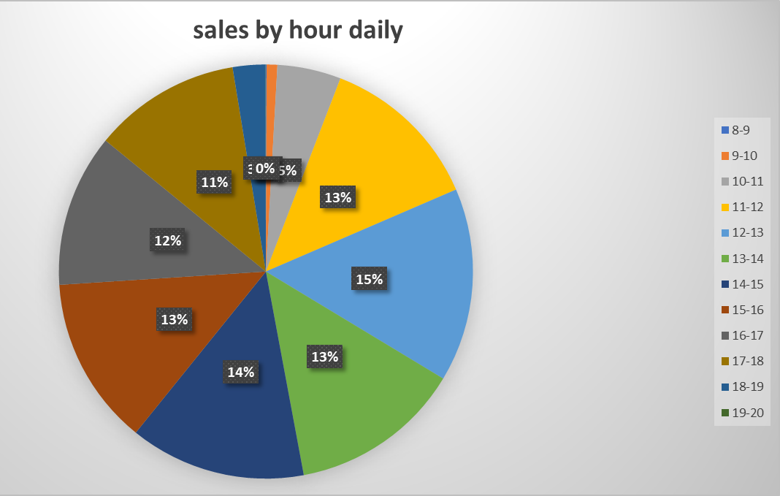
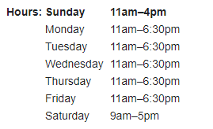
Average Daily Sales (ADS) by Day
Majority of sales occur from 11am onwards, with the exception of Saturday
Potential changes to consider:
Sat 9-10am – ADS are ~40% of the peak average (11am-6pm)
Mon-Fri & Sun 10-11am – ADS are ~30% of the peak average (11am-6pm)
Mon-Fri 6-6:30pm – ADS are ~26% of the peak average (11am-6pm). Factoring in that there is only 30 mins, if we were to assume same sales from 6:30-7pm, ADS are still only ~52% of the peak

Slide 4
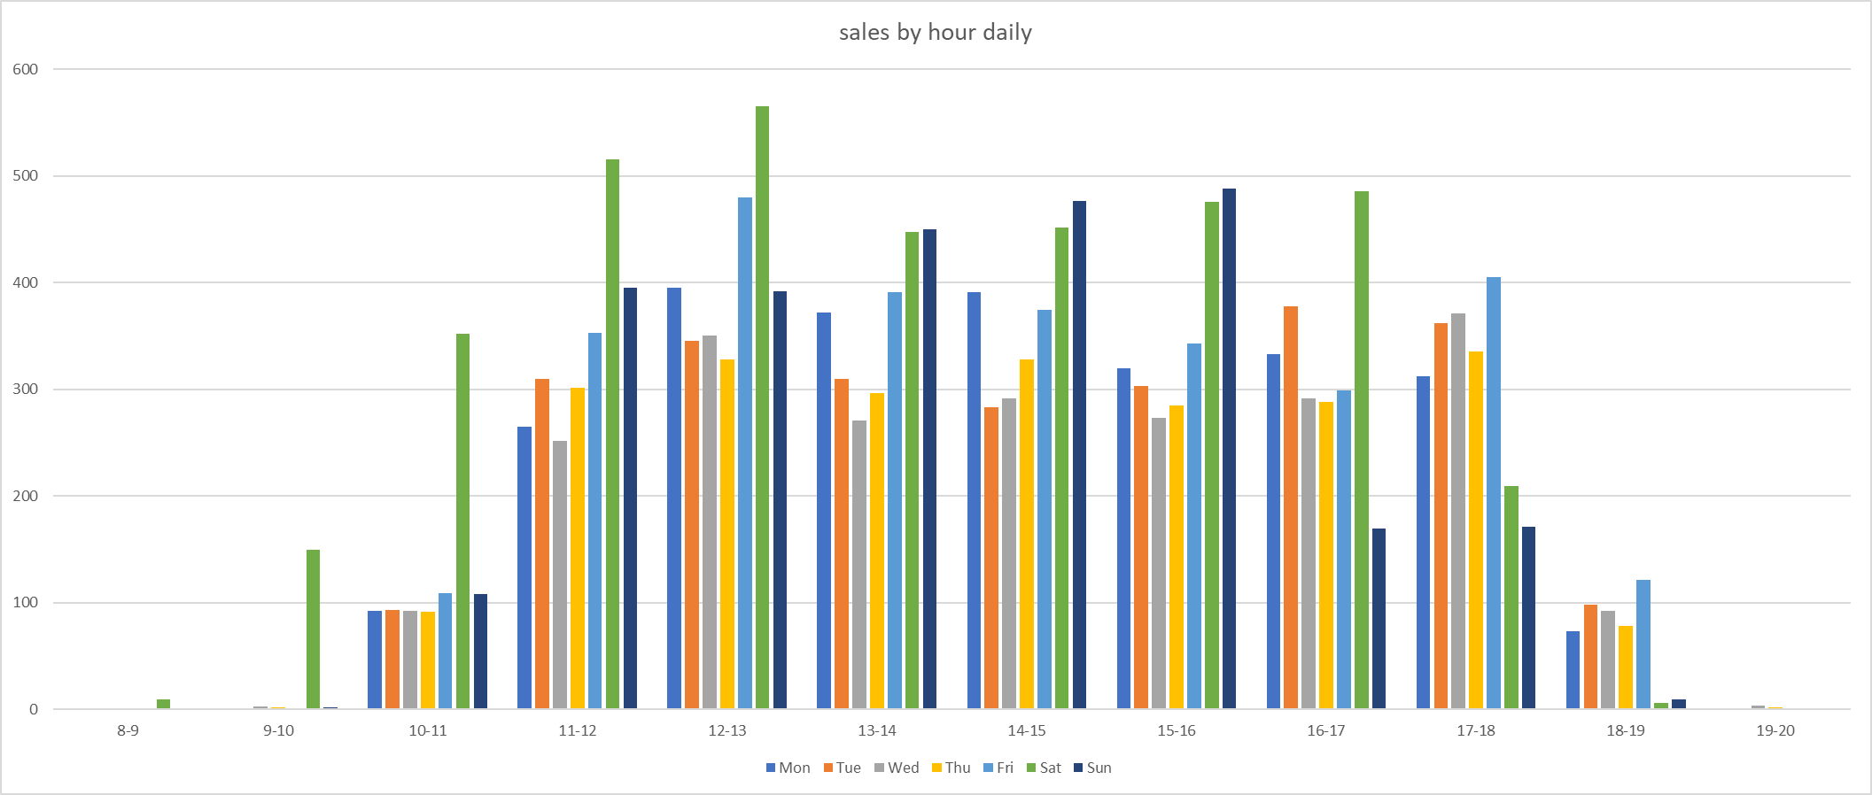
Average Daily Sales by hour by day (Jul 2020 – Sept 2021)

Slide 5
Average Daily Sales by hour by day (Jul-Dec 2020)
However, prior to Jan 2021, Alfalfa was open until 6pm on Sat & Sun
Sat 5-6pm was the strongest day of the week for that time period
Sun 4-5pm & 5-6pm still relatively strong
Could consider re-opening those times

Slide 6
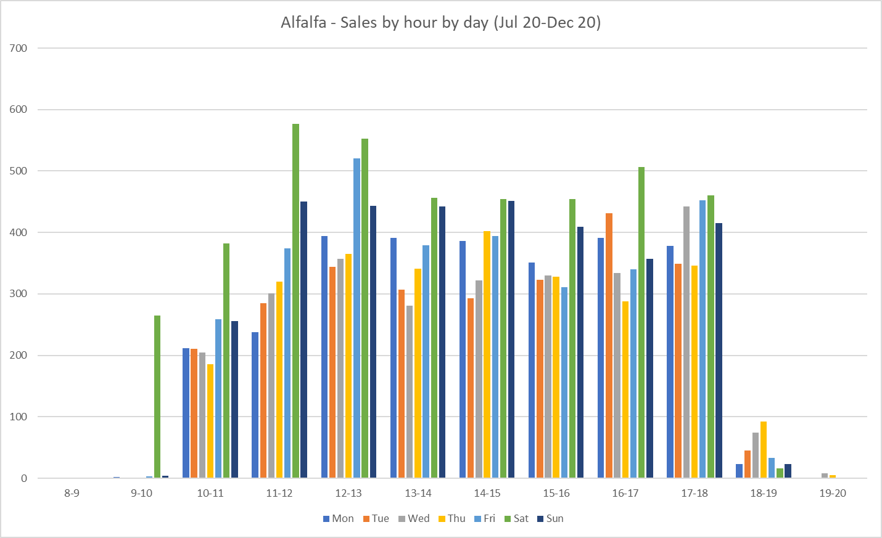
Average Daily Sales by hour by day (Jul-Dec 2020)

Slide 7
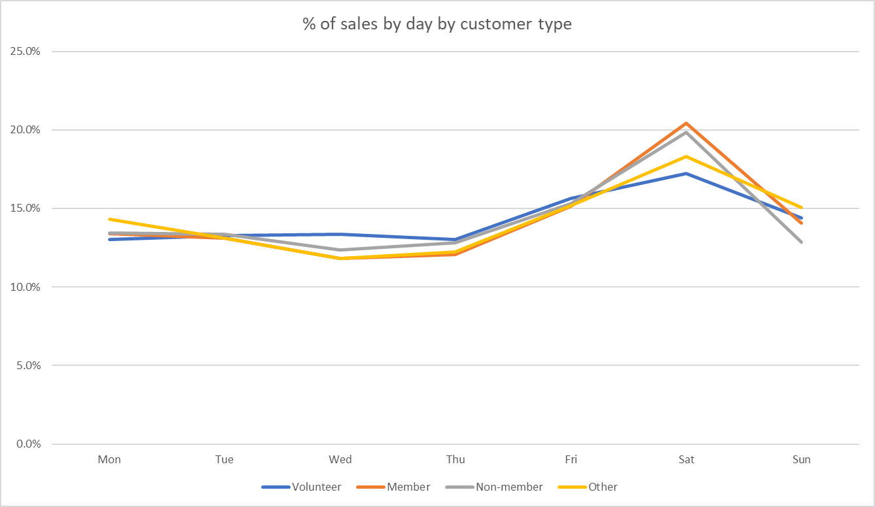
Sales by day of the week does not significantly vary by customer type

Slide 8
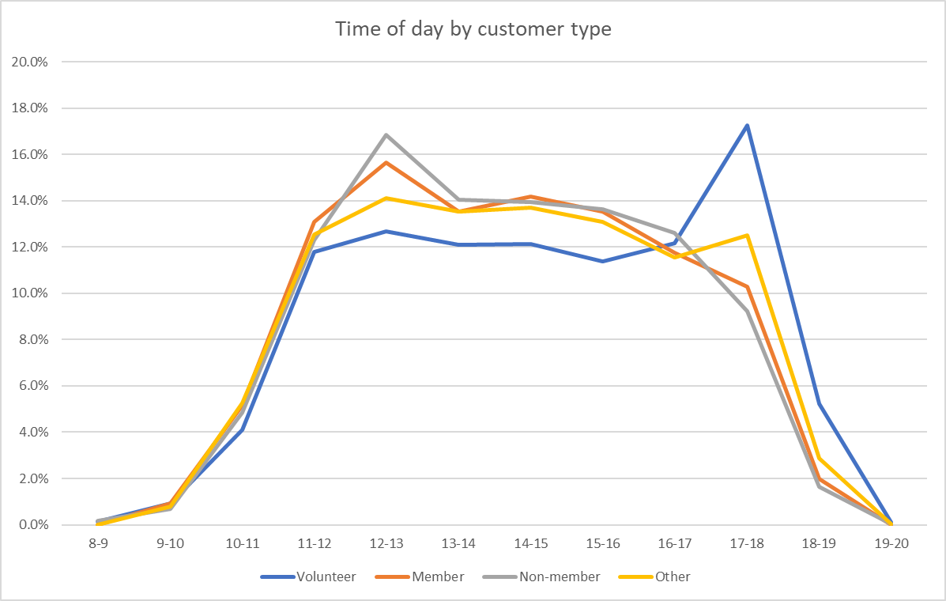
Sales by time of day does not significantly vary by customer type, except for volunteers at end of day

